Slide 1


2016-2017 Budget Call
Diana Keelen, Budget Commiteee Co-Chair
Dr. Irit Gat, Budget Committee Co-Chair
Administrative Council Meeting, November 17, 2015

Slide 2
Recap of 2015-2016
152 Budget requests received
Total requests were $9,286,128
One-time: $6,504,720
On going: $2,781,408

Slide 3
2015-2016 Adopted Budget Summary
Unrestricted fund set aside for resource allocation ($5.6 million):
$1,450,000 on going funds (including classified/CMS staffing)
$545,000 one time funds
$1,162,571 set aside for negotiations on going
$447,439 set aside for negotiations one time
$1,236,222 in faculty hiring
$819,497 in step/column, STRS & PERS increases

Slide 4
2015-2016 Non Staffing Requests

Slide 5
2015-2016 Funded Budget Requests

Slide 6
2015-2016 Unrestricted Staffing & Non Staffing Budget

Slide 7
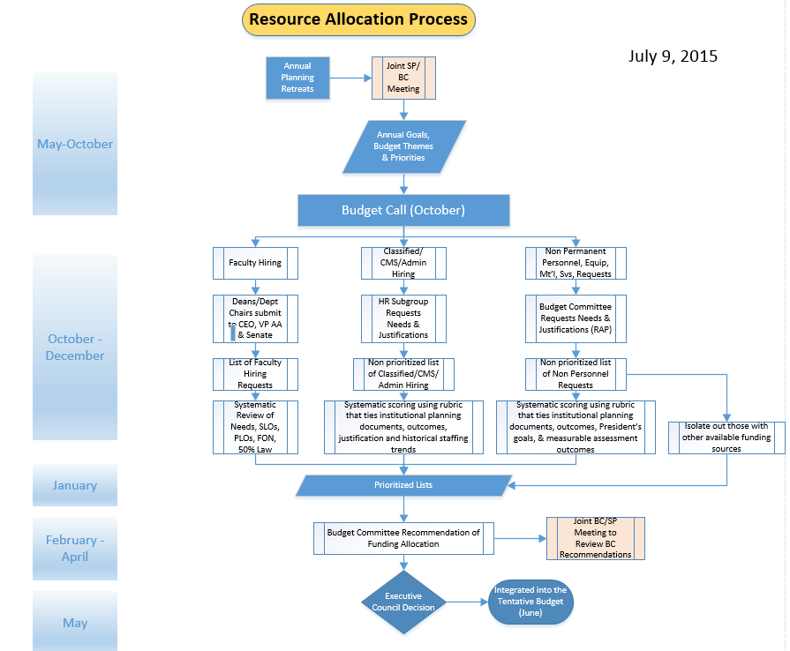
Resource Allocation Process

Slide 8
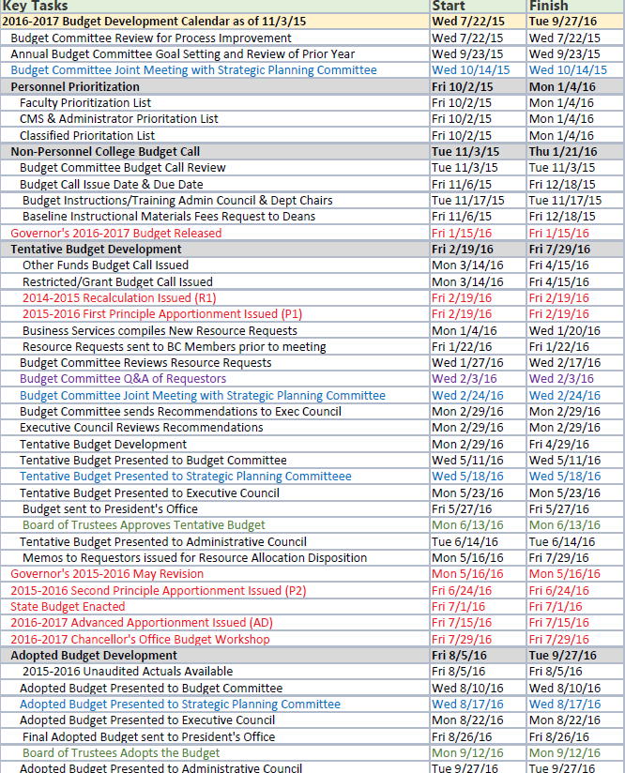
Budget Calendar
BUDGET CALENDAR

Slide 9
Budget Instructions
Must have current program review or annual update
Requests must be approved if involves the following:
Marketing: Executive Director of Marketing & Public Relations
Financial Systems: Executive Director of Business Services
Audio Visual Equipment or Information Technology Equipment: Executive Director of Information Technology Services
Facility Alteration & Repair and Vehicles: Executive Director of Facilities Planning
Requests are for above base line items. Do not include your baseline budget amount.
Identify if partial funding is acceptable and the amount.
If the request is for equipment, then please submit a resource allocation proposal for each piece of equipment unless this is relating to successful completion of a project. For example, the request is for two carts. Submit a request for each cart. Another example would be if there is a project to implement security gates in the library. The project requires 4 security gates. A request for each security gate is not necessary because it relates to the replacement of security gates project. Only one proposal is necessary in this case.
Each administrator must assign a priority rank to the requests coming from their areas. For example, you have 5 total requests. The administrator must assign #1 as the first priority, #2 as the second and so on.

Slide 10
Budget Request Structure
• Inst. Advancement
• IERP
• PIO/Marketing
• Business Services
• Facilities
• ITS
• Academic Division #1
• Academic Division #2
• Academic Division #3
• Academic Division #4
• Academic Division #5
• Risk Management
• Student Life & Development
• Enrollment Management
• Counseling & Matriculation
• Office of Student Services
• Office of Human Resources/Payroll
• Office of Academic Affairs
• Office of the President

Slide 11
Operational versus Academic
Operations is typically the general operation of the college. Meaning when the campus opens its doors there are things that must function in order for the college to operate, e.g., the facility, utilities, wi-fi, systems, networking, administration, etc. It is the indirect support to our educational and student support activities.
Academic/Non- Operational is typically tied to the direct instruction of students or the support services that affect student learning outcomes and program learning outcomes. Typically it is tied to some sort of program. Such as classroom that requires instructional materials & equipment, counseling programs, library services, etc.
Operational Request | Academic/Non Operational Request
Maintaining Health/Safety | Provide environment which supports learning and facilities student success
 | Increase in transfer rates
Ensuring Compliance | Expand and diversify career & tech ed options
Enhancing Operational Support | Increase student success in basic skills and ESL courses
Utilize campus resources efficiently and effectively | Utilize campus resources efficiently and effectively
Maintain & enhancing community partnerships | Maintain & enhancing community partnerships
Increase resources to enhance technology support of mission & processes | Increase resources to enhance technology support of mission & processes

Slide 12
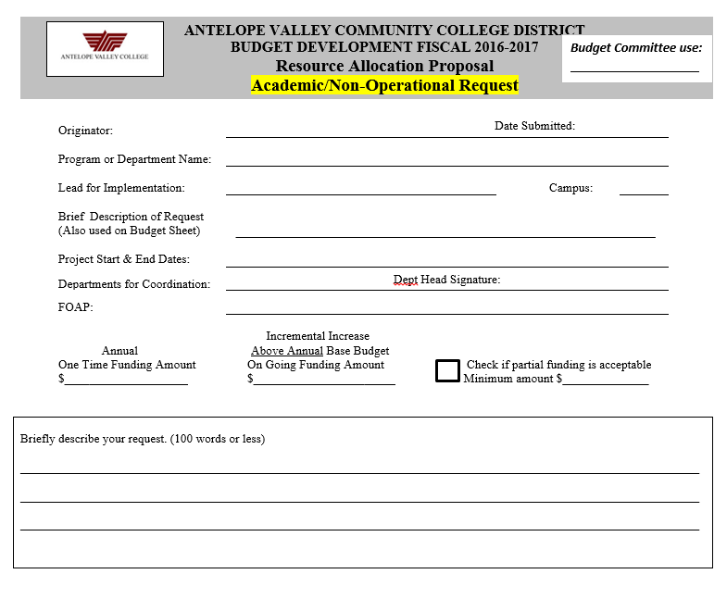
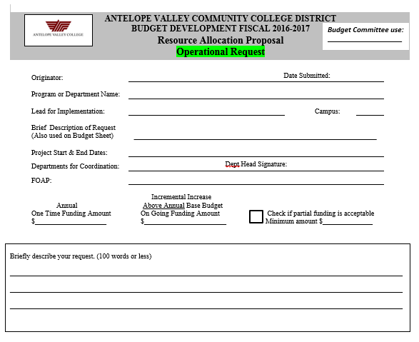
Resource Allocation Proposal

Slide 13
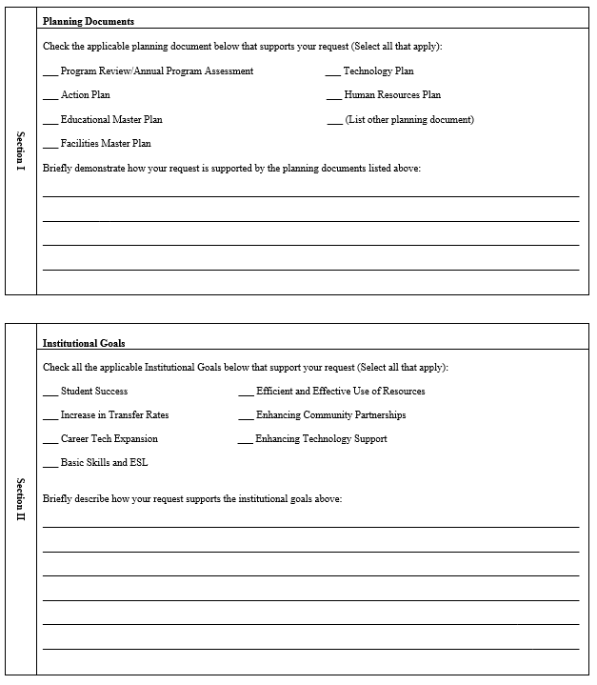
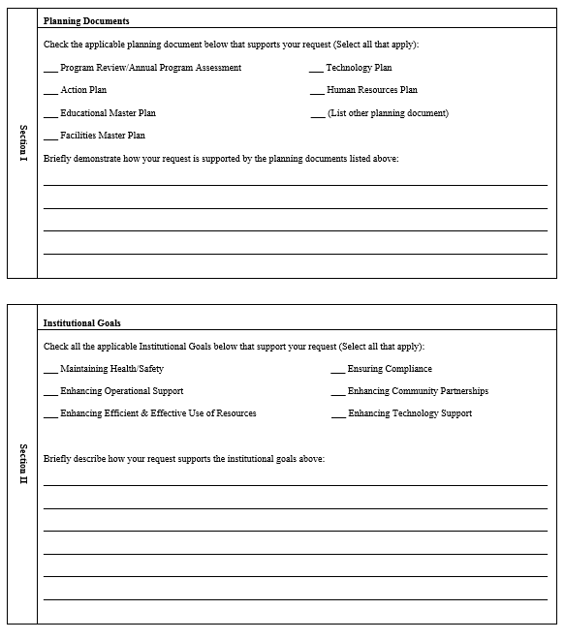
Resource Allocation Proposal
Academic/Non Operational
Operational

Slide 14
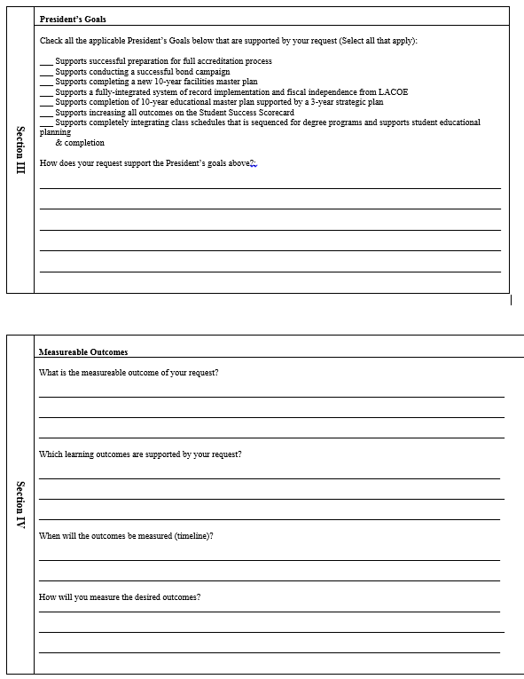
Resource Allocation Proposal

Slide 15
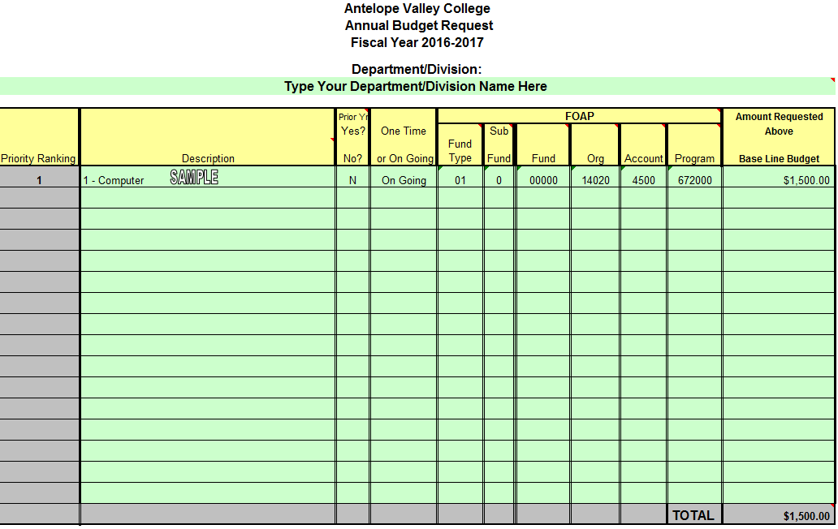
Request Ranking Sheet

Slide 16
Budget Calls
Issued Due
District budget call 11/6/15 12/18/15
Instructional Materials 11/12/15 12/18/15
Categorical/Grants 3/14/16 4/15/16
Other Funds 3/15/16 4/15/16

Slide 17
Questions?

